Slide 1
Anatomy of a Smart Nozzle
10/3/22

Slide 2
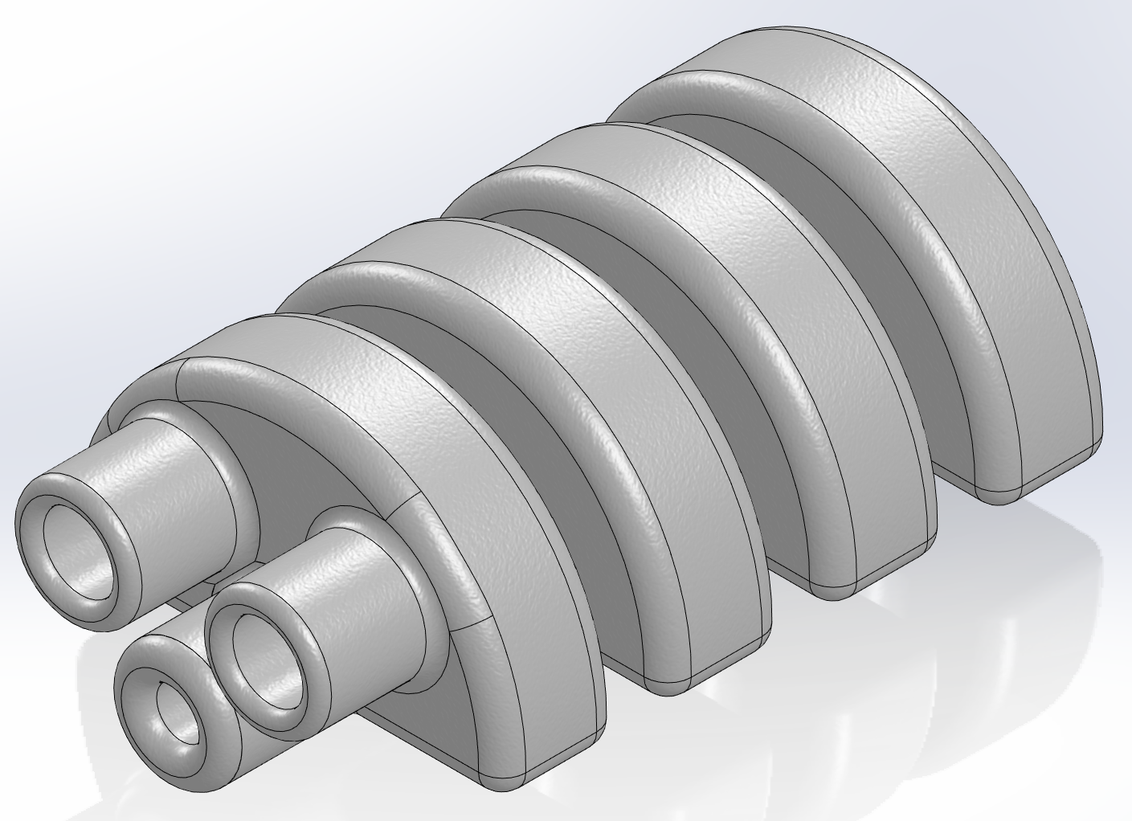
Anatomy of a Smart Nozzle - Sections
A section in the smart nozzle is defined as the body components the make up and enclose the pockets of each nozzle. This design has 4 sections.
4
3
2
1

Slide 3
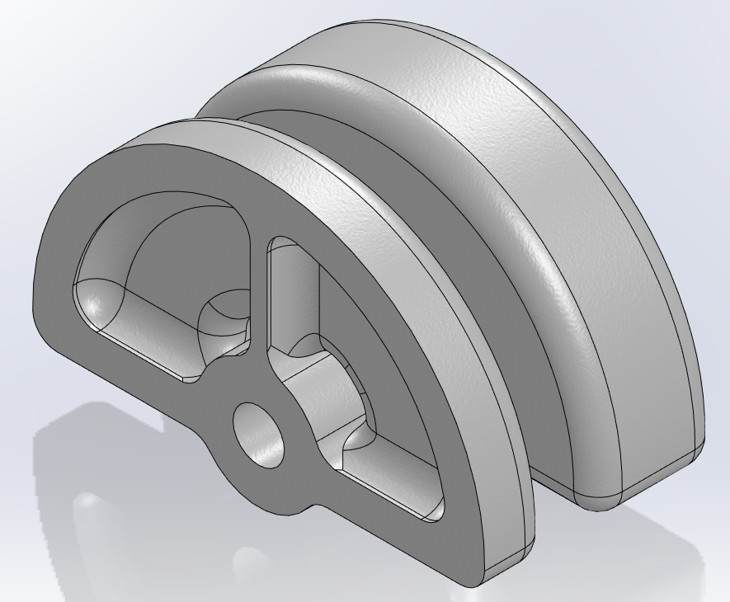
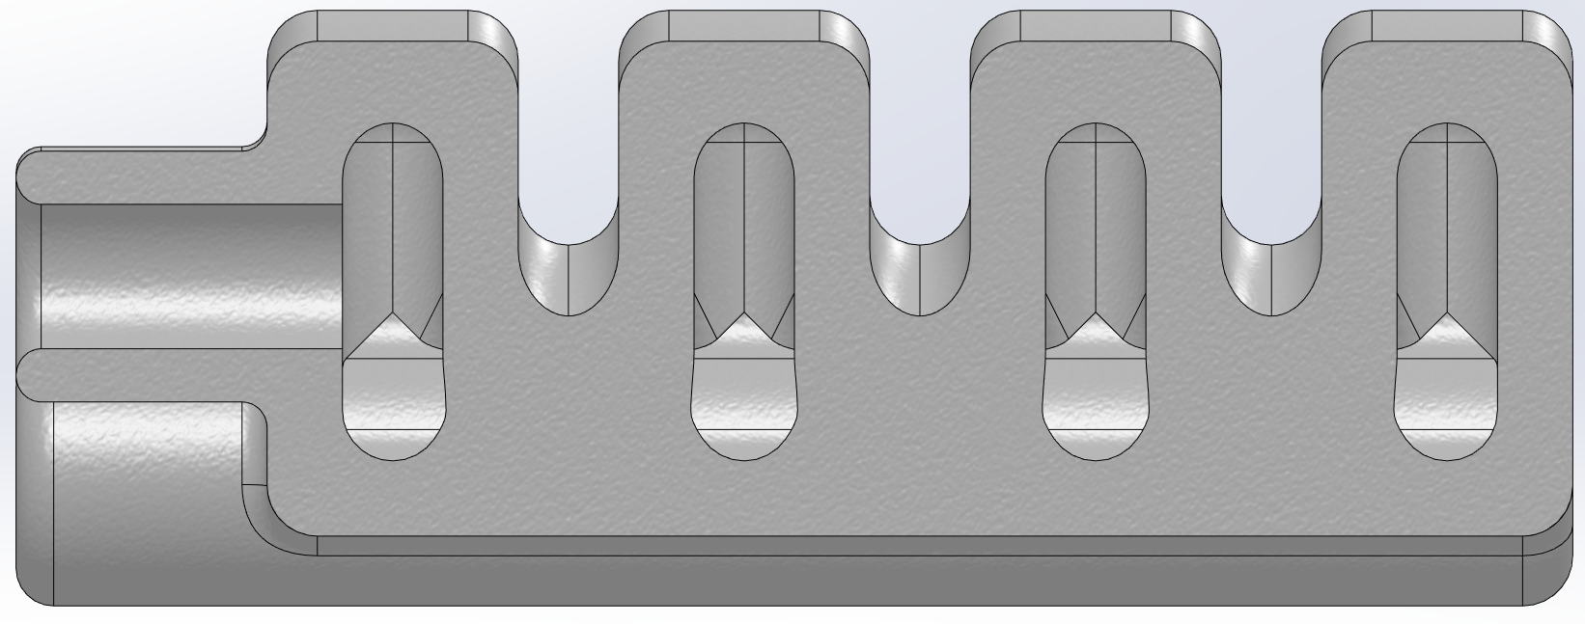
Anatomy of a Smart Nozzle - Pockets
A pocket is defined as open space designed to inflate with air. Each section contains two pockets in this design and can be seen in the top right photo. In the bottom right photo, we can see that 4 pockets make up a chamber.
1
2

Slide 4
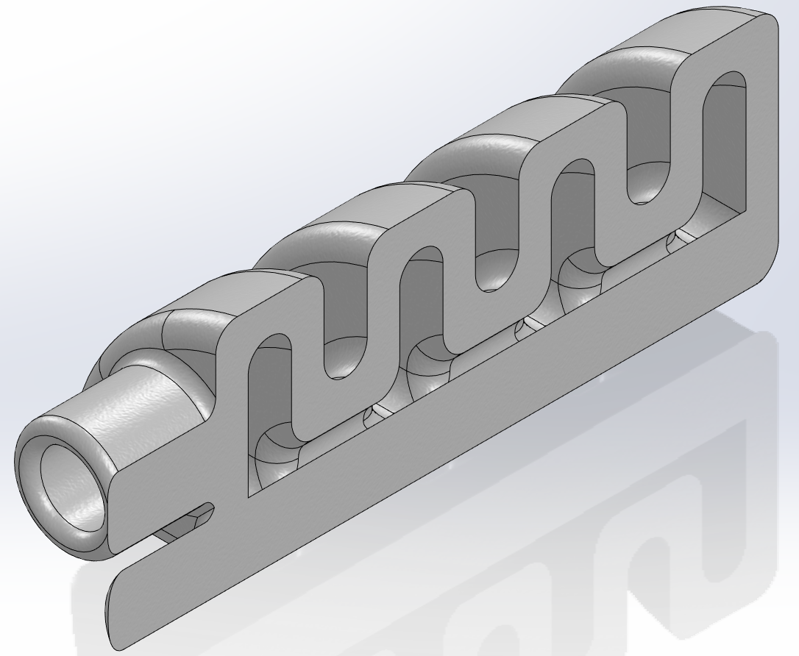
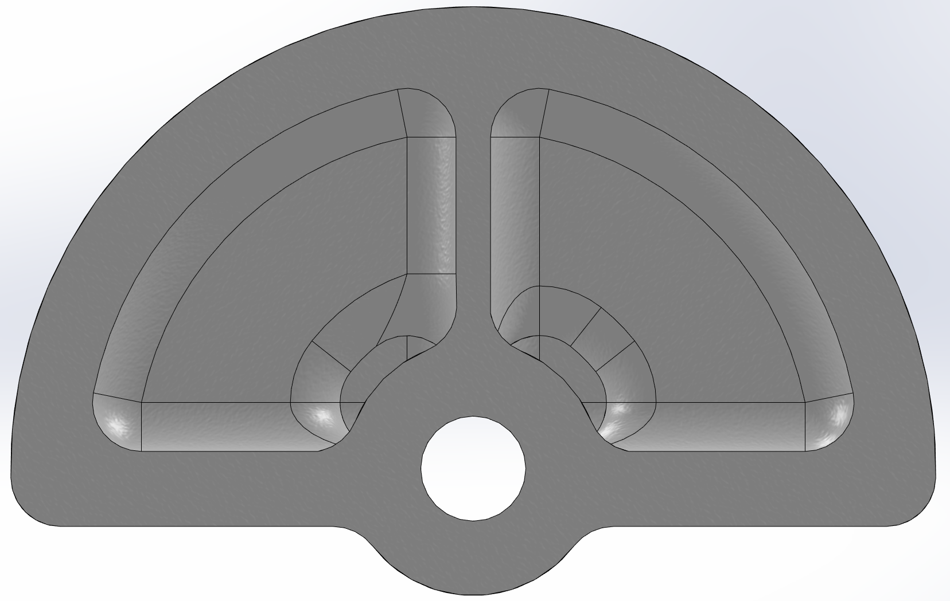
Anatomy of a Smart Nozzle - Chambers
4
A chamber is defined as the sum of all connected pockets. The chamber is what is pressurized a affects displacement. In this design, each chamber has four pockets (top right) and there are two chambers (bottom right).
3
2
1
1
2

Slide 5
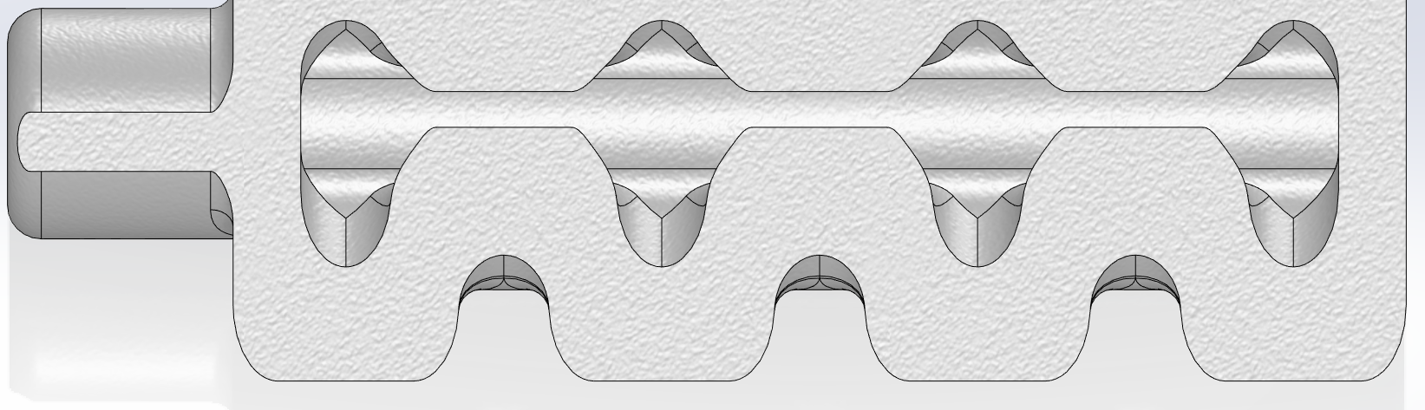
Anatomy of a Smart Nozzle -Airway
The airway of a smart nozzle is the section that connects each pocket to one another. It allows the air to flow through the entire chamber.

Slide 6
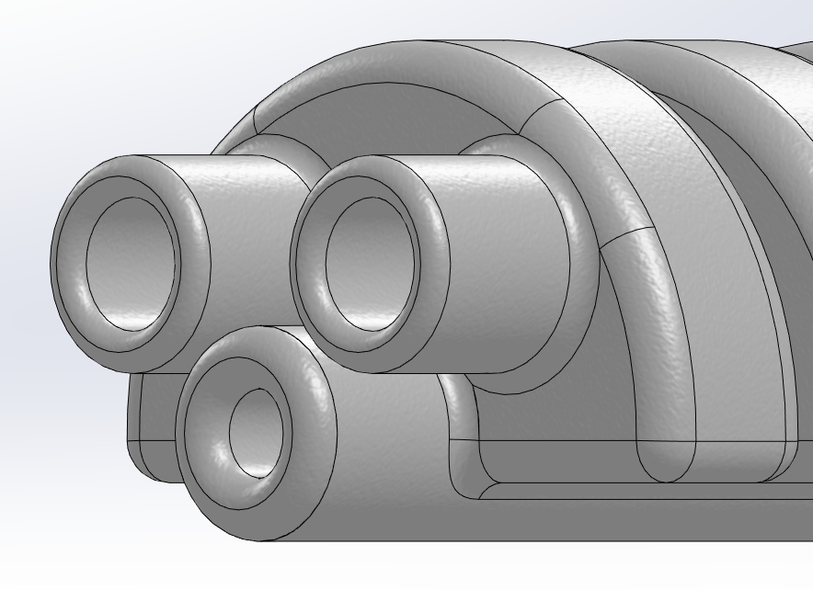
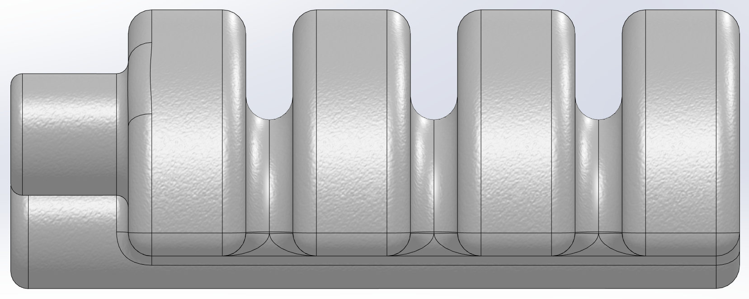
Anatomy of a Smart Nozzle -Other Components
1
2
Connectors – points where you can connect air or coolant flow (top right). 1 & 2 are meant to accept air and 3 is for coolant hookup.
Bridges – the material connecting each section. Its only internal component is each airway. Since there are 4 sections are 3 bridges (bottom right)
3
1
2
3

